Slide 1
Unity Week 1
Intro to Unity Scripting

Slide 2
Questions?

Slide 3
Agenda
Unity API Location
Monobehaviour
Common Methods
Getting Input
Input Settings
Components

Slide 4
Accessing the Unity API
The Unity Scripting API is a reference to all the code options available to script with.
Manual: https://docs.unity3d.com/Manual/index.html
Scripting API: https://docs.unity3d.com/ScriptReference/index.html

Slide 5
What is Monobehaviour?
Monobehaviour is a base class that gives us most of the functionality available in the Unity Engine core loop.
Unity scripts that are using Unity methods should inherit from Monobehaviour.
This means in most cases when working with non-editor scripts, you will inherit from Monobehaviour.

Slide 6
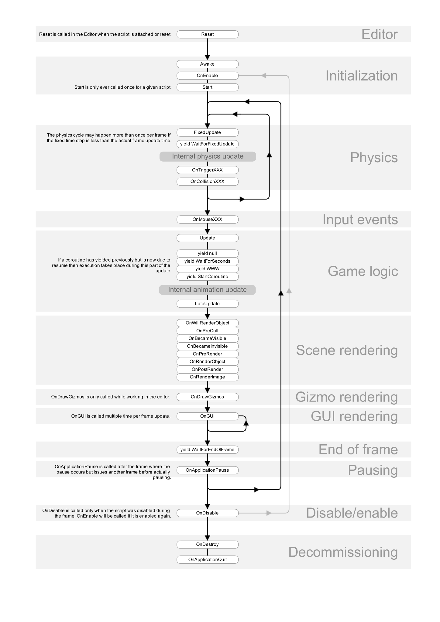
Common Monobehaviour Methods
Awake() - First method group that is called during initialization. Often used to set-up key functionality that needs to be running for the program to work.
Start() - Last method group called during initialization. Often used to initialize values for use in the program.
Update() - This method is repeatedly ran every frame of the program.
FixedUpdate() - This method is repeatedly ran with the physics calculation functions.
LateUpdate() - This method is repeatedly ran but at the end of the core gameplay loop.

Slide 7
Gathering Input
Input Class: https://docs.unity3d.com/ScriptReference/Input.html
Keycodes
Keycodes are enums that allow us to identify which key we are targeting or looking for.
GetKey, GetKeyDown, GetKeyUp
Getkey returns every frame the button is interacted with
Getkeydown only occurs once during the frame the key is pressed.
Getkeyup only occurs once during the frame the key is released.
GetButton, GetButtonDown, GetButtonUp
Buttons are named keys that can be bound in the Input settings windows.
Getbutton returns every frame the button is interacted with
Getbuttondown only occurs once during the frame the key is pressed.
Getbuttonup only occurs once during the frame the key is released.

Slide 8
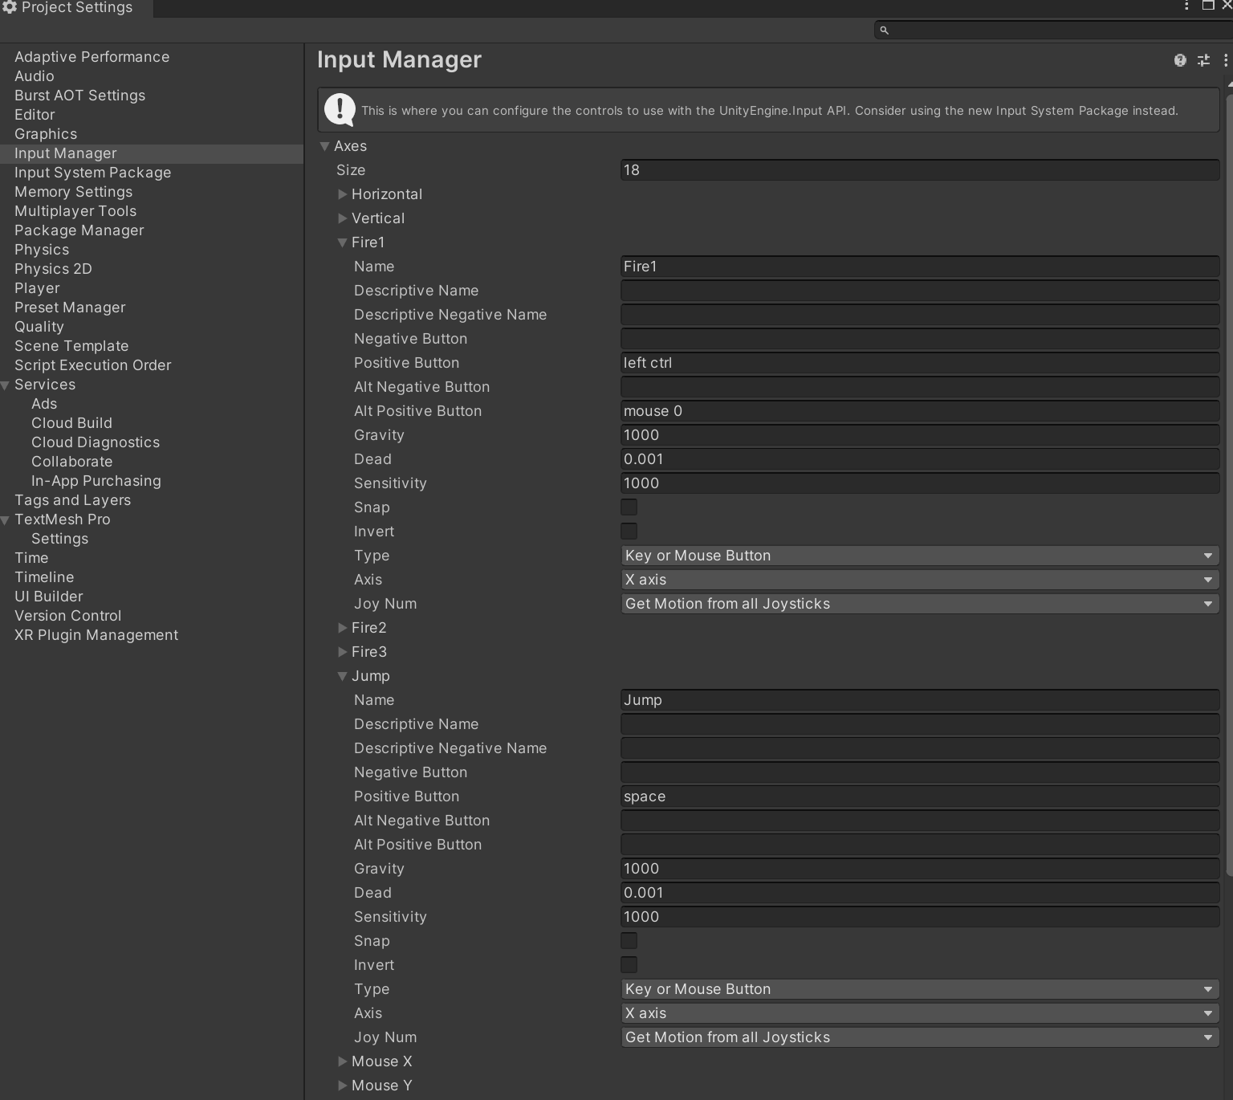
Input Settings

Slide 9
What are Components?
Components allow us to add behavior to game objects.
Game objects are empty allocations of data that have no behavior on their own.
To give game objects behaviors and functionalities, we add components
Components can be scripts, audio, renderers or anything else.
To alter how a game object behaves in unity we must modify the components of the object.
GetComponent<ComponentType>(); = This is a method that allows us to return the component we are looking for (denoted in the <>). We can store this in a variable so we can alter it later.

Slide 10
Coding Challenges
Using Input!
Create an InputController script and attach it to the main camera.
When the user presses theses keys, they should get these outputs printed in the console:
W: “Going Forward”
A: “Going Left”
S: “Going Backward”
D: “Going Right”
When the user presses the “Fire1” button, print to the console “I shot something”.
Ensure that these messages only appear once per input press.
Hello World In Unity!
Create a script named “HelloWorld” in Unity
Attach the script to the main camera
In the script, print “World Starting…” at the beginning of initialization
Print “World Started” at the end of initialization
Print “I’m Inside the World” every frame.
*Tip: In the Unity console, click “collapse” so that all messages with the same content are stored in the same row.
Submission: Submit just the .cs files in a zipped folder named “Unity Week 1 Challenges”

